Slide 1
IBC Project „LNG in Road Traffic“ Workshops
Detlef Weßling

Slide 2
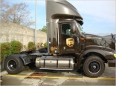
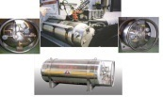
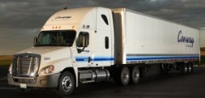
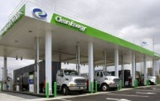
The Aims of the Project (1)
Right conditions for successful market development for LNG-powered trucks in the transit zone between E. & W. Europe
The levels to which the different markets have developed will be compared in terms of
standards and practices,
infrastructure,
supply and demand,
the political framework.
The problems will be analysed in 4 regional workshops and approaches to solutions will be defined.

Slide 3
The Aims of the Project (2)
Right conditions for successful market development for LNG-powered trucks in the transit zone between E. & W. Europe
The project office under the patronage of the IBC will act as organiser and central point of contact.
It will gather all the findings together and from them will develop position and concept papers that make recommendations for developing the market.
Gather Findings
Concept Papers
Recommendations
LNG in Road Traffic IBC

Slide 4
Project Topics & Organisation
Steering Committee
Mr. Fip, Mr. Aksyutin, Mrs. Blagova
Project Office
E.ON / GAZPROM
+ Agency
Project Management
E.ON (Mr. Weßling)
GAZPROM (Mr. Gaidt, Mr. Likhatshev)
Working group 1
Standards Practices
Working group 2
Vehicles
(trucks)
Working group 3
Customers
(Fleets)
Working group 4
Infrastructure
Service stations
Working group 5
Politics
Funding
Commercialisation
Members of the Project Office:
OOO Gazprom Gazomotornoye Toplivo: Mr. Urshumtsev
OOO Gazprom Transgas Jekaterinburg: Mr. Eduard Gaidt (Mr. Kusnezov)
E.ON Technologies GmbH: Mr. Müller-Trimbusch
Advisers: Mr. Pronin (Gazprom Export), Mr. Schumann (E.ON Global Commodities)

Slide 5
Countries of Investigations & Locations of the 4 Workshops
Yekaterinburg
Russia
Belarus
Riga
Latvia
Estonia
Lithuania
Prague
Czech Republic
Poland
Berlin
Germany
5

