Slide 1
World
NGV Market Development

Slide 2
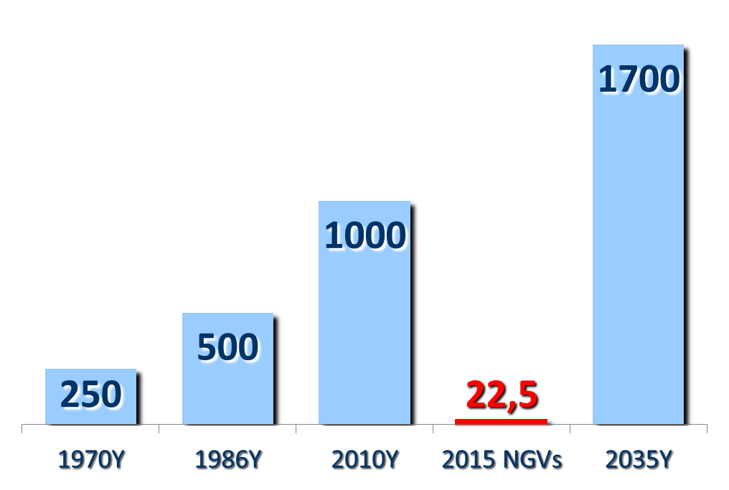
World population
of on-road vehicles, millions
2,2%
Sources:
http://podrobnosti.ua,
http://voditeliauto.ru,
http://www.zr.ru,
http://motor.ru
2015 NGVs
MetanoGraph

Slide 3
World NGV Market Indicators
Sustainable development of the market
MetanoGraph

Slide 4
World NGV Market Indicators
Correlation between oil prices and CNG demand
MetanoGraph

Slide 5
World NGV Fleet Composition
Source: NGVA Communications Group
MetanoGraph

Slide 6
World NGV Fleet Composition
Million NGVs:
18,9
1,6
0,9
1,1
Source: NGVA Communications Group
MetanoGraph

Slide 7
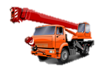
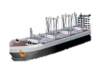




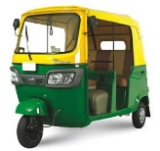

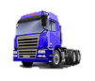

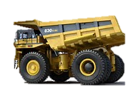
Best Application Sectors
КПГ
СПГ
CNG
LNG

Slide 8
CNG & LNG Demand till 2030, Bcm
2012
2030
Source: Wood Mackenzie
MetanoGraph

Slide 9
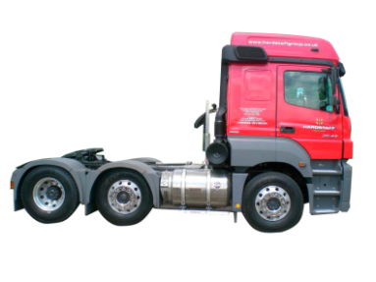
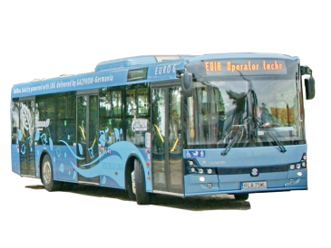
European LNGVs Population
∑ ≈ 1070
Trucks
1
3
69
1
638
291
33
46
4
7
Buses
2
Источники: NGVA Europe, Gazprom export
MetanoGraph

Slide 10
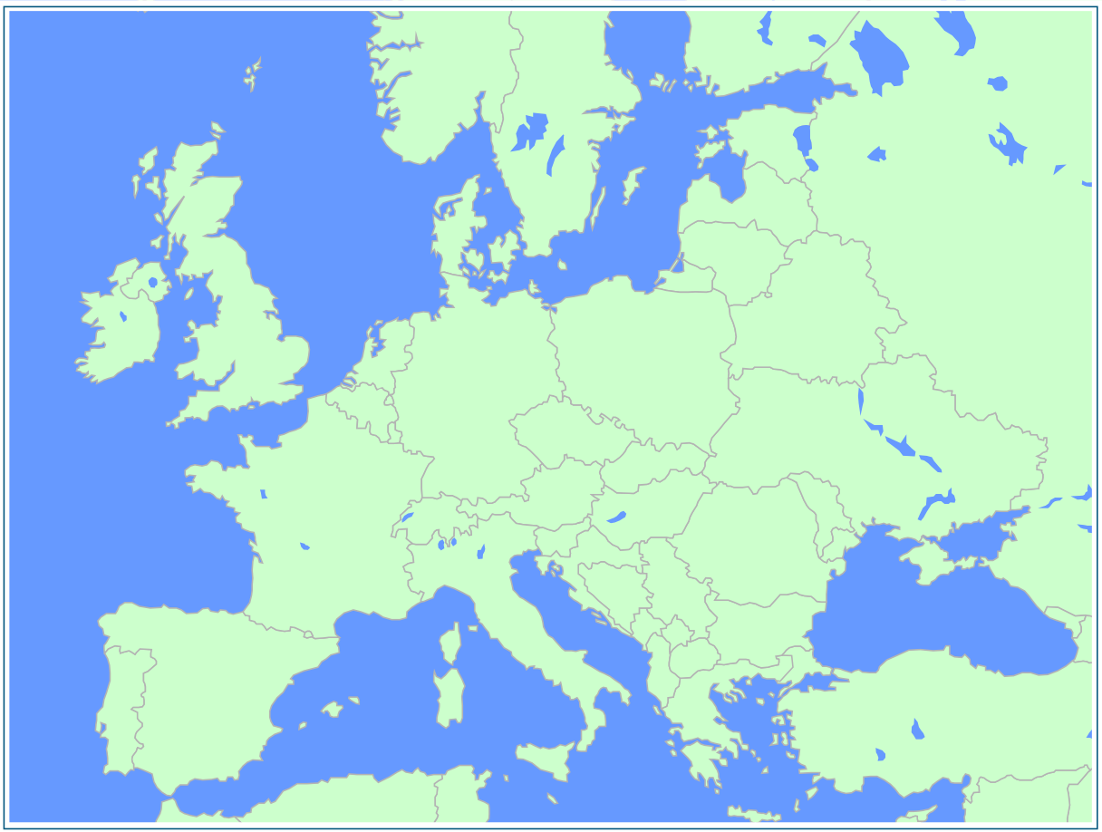
LNG Filling Stations in Europe
Liquefied natural gas (LNG) to Europe isn’t a get-rich-quick scenario for the impatient investor.
Robert Bensh, the Managing Director and partner with Pelicourt LLC, USA
Sources: VOS logistics, NGVA Europe, Gazprom export
MetanoGraph

Slide 11

LNG Price @ Pump (incl. VAT)
Источник: LNG24, Нидерланды
MetanoGraph

Slide 12

EU Project
LNG Blue Corridors
2013 - 2017
GZP/EON
LNG 4 Trucks Project
2015 - 2017
Building 14 new LNG or L-CNG stations
Building up a fleet of about 100 LNG Heavy Duty Vehicles
LNG Blue Corridors will run for 4 years
LNG Blue Corridors will connect 12 Member States
EU co-funding into infrastructure € 8 Mio
Building 4 – 5 new LNG stations in the Baltic area
Cooperating with transportation companies
Integration of LNG projects on roads and at sea

Slide 13
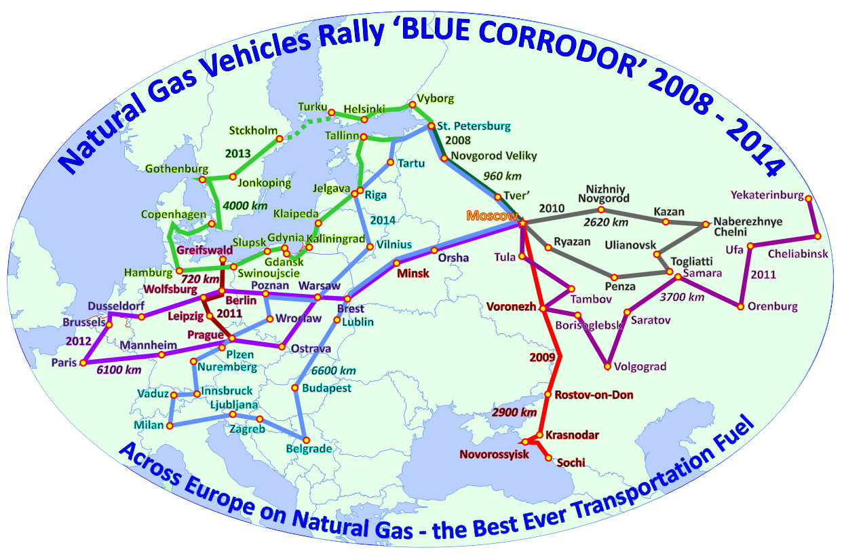
Blue Corridor

Slide 14
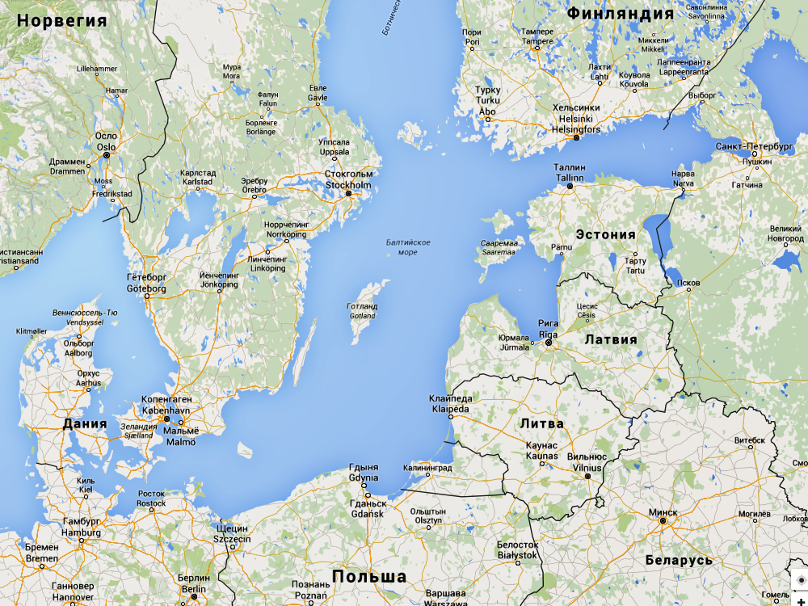
Автопробег «Голубой коридор – 2016: Янтарный путь»
Turku
Helsinki
St-Petersburg
Tallinn
Stockholm
Gethenburg
Riga
Copenhagen
Klaipeda
Gdansk
Rostock
Szeczen
Hamburg

Slide 15
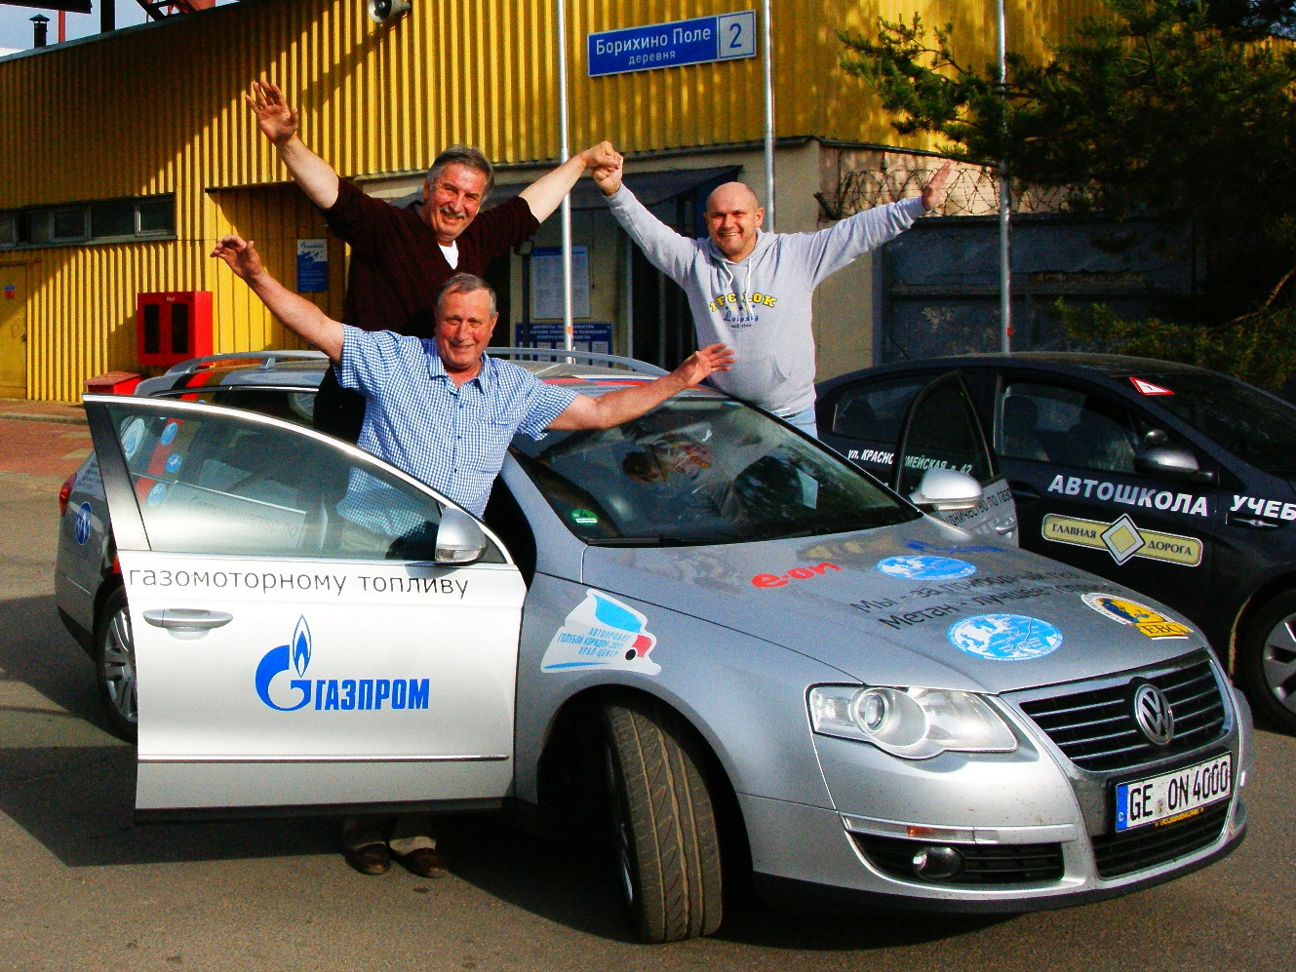
Thank you
Evgeny Pronin
Gazprom export LLC
October 2015

Slide 16

NGV Market in the Czech Republic
2015 forecast
Sources: NGVA Communications Group, Gazprom export, G+ Europe
MetanoGraph

Slide 17
European NGV Fleet 2015
Europe:
∑ 1.2 Mio
1 | Italy | 823 000
2 | Germany | 96 349
3 | Russia | 90 000
4 | Bulgaria | 61 623
5 | Sweden | 44 322
6 | France | 13 538
7 | Switzerland | 11 058
8 | Czech Rep | 10 820
9 | Austria | 7 717
10 | Belarus | 4 600
11 | Hungary | 4 062
12 | Spain | 3 781
13 | Poland | 3 392
14 | Moldova | 2 200
15 | Finland | 1 302
16 | Slovakia | 1 284
17 | Other | Less than 1000
Sources: NGVA Communications Group, Gazprom export, G+ Europe
MetanoGraph

Slide 18
European CNG Demand 2015
Europe:
∑ 3.6 Bcm
1 | Spain | 1 128,7
2 | Italy | 900,0
3 | Russia | 405,0
4 | Germany | 276,0
5 | Norway | 196,8
6 | Bulgaria | 180,0
7 | Austria | 162,0
8 | Sweden | 140,4
9 | France | 72,0
10 | Czech Rep | 38,0
11 | UK | 36,0
12 | Switzerland | 19,3
13 | Greece | 16,0
14 | Portugal | 13,9
15 | Belarus | 12,4
16 | Slovakia | 12,0
17 | Other | Less than 10 Mcm
Sources: NGVA Communications Group, Gazprom export, G+ Europe
MetanoGraph

Slide 19
European CNG Stations 2015
Europe:
∑ 3670
1 | Italy | 1 022
2 | Germany | 915
3 | France | 344
4 | Russia | 272
5 | Austria | 205
6 | Sweden | 203
7 | Switzerland | 167
8 | Bulgaria | 106
9 | Czech Rep | 94
10 | Spain | 78
11 | Poland | 47
12 | Belarus | 42
13 | Norway | 26
14 | Moldova | 24
15 | UK | 22
16 | Finland | 19
17 | Other | Less than 15
Sources: NGVA Communications Group, Gazprom export, G+ Europe
MetanoGraph

Slide 20



Czech NGV Industry
NGVs
Major CNG Stations Operators
LNG equipment
CNG cylinders

